Slide 1



NLP Project
group6: Razan, Bader & Raghad

Slide 2

Table Of Contents
1
Introduction
2
project overview
3
Conclusion

Slide 3

Introduction
1

Slide 4



Objective
To build a classifier that can distinguish between fake and real news based on the article's title and content.

Slide 5

Project overview
2

Slide 6





Data Overview
Data Cleaning & PreProcessing
Dataset features: title, text, subject , date and label
Removed missing data
Lowecased text
Removed punctuation and stopwords
Tokenization and Lemmatization
Feature Extraction
Models Used
TF-IDF Vectorization
consider unigram &bigrams
Logistic Regression
SVM
XGBoost
Random Forest
Swifter library

Slide 7


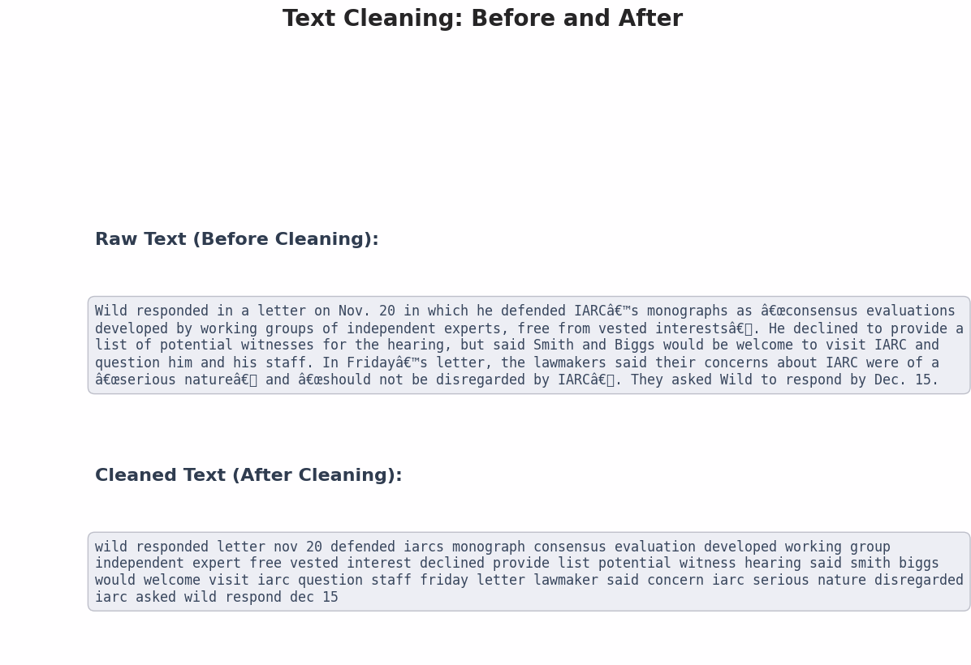
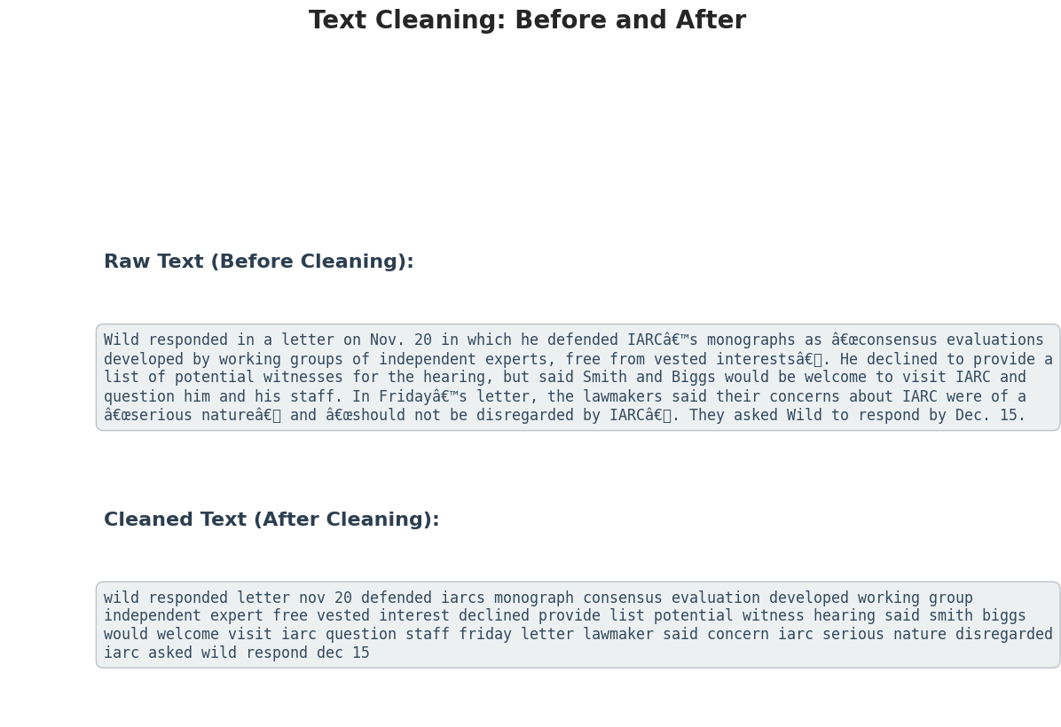
Data Cleaning

Slide 8
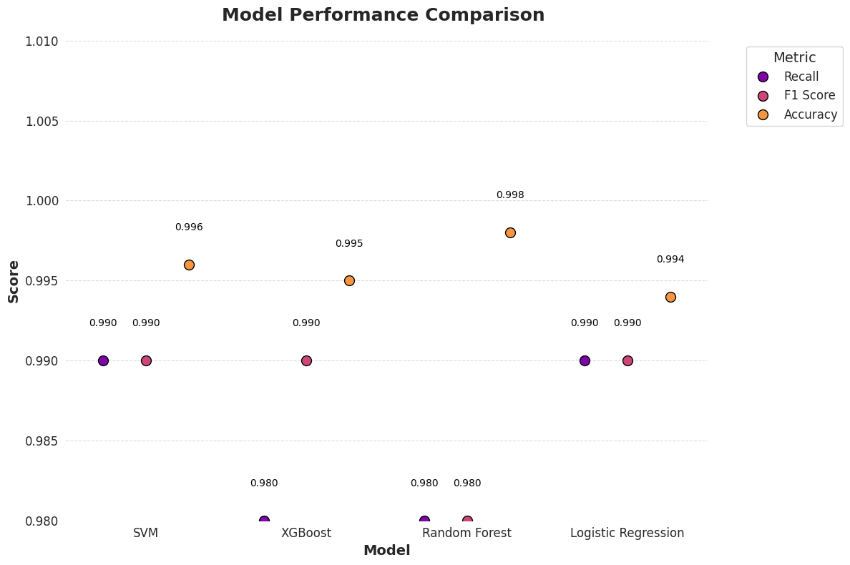


Slide 9
3
conclusion

Slide 10
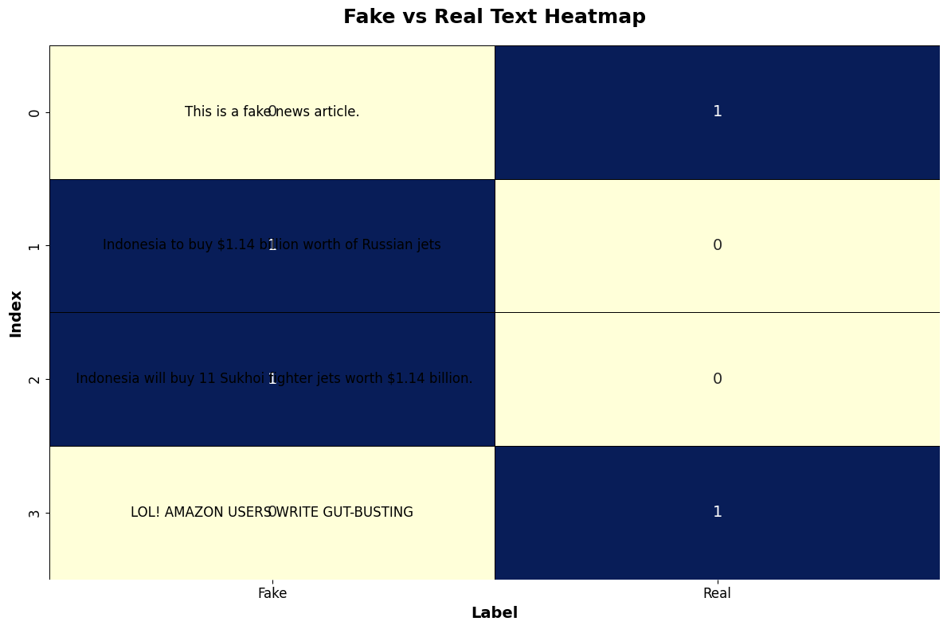


Slide 11

Swifter Library accelerate the data cleaning
High accuracy becuase it’s a simple dataset
The best model is Random Forest

Slide 12

Thank you

